Slide 1

CS205 Object Oriented Programming in Java
Module 3 - More features of Java (Part 1)
1

Slide 2





Topics
Introduction:
Packages and Interfaces:
Defining Package,
CLASSPATH,
AccessProtection
Importing Packages
2

Slide 3
Package
Packages are containers for classes.
A package in Java is used to group
interfaces.
related classes and
They are
used to keep the class name space
compartmentalized.
– For example, a package allows us to create a class named List, which we can store in our own package and it will not collide with some other class named List stored elsewhere.
Packages are stored in a hierarchical manner.
The package is both a naming and a visibility mechanism.
control

Slide 4
Packages(contd.)
We can define classes inside a package
– that are not accessible by code outside (default)
that
package.
OR
– that can be also package. (protected)
accessed by subclasses outside the
OR
– That can be accessed by all classes in all packages(public)
4

Slide 5
Defining Package
To create a package, simply include a package command as the first statement in a Java source file.
– All classes declared in that file will belong to the specified package.
The package statement defines a name space in which classes are stored.
If we are not writing package statement, the class names are put into the default package, which has no name.
5

Slide 6
Defining Package(contd.)
General form for creating a package : package packagename;
Example: If we write the following statement at the beginning of our java program then it will create a package named Oop.
package Oop;
6

Slide 7
Defining Package(contd.)
Java uses file system directories to store packages.
Example: Any classes that we declare to be part of the package Oop must store their .class files in a directory called Oop.
Any file can include the same package statement.
The package statement simply specifies to which package the classes defined in a file belongs to.
7

Slide 8
Defining Package(contd.)
We can create a hierarchy of packages.
Separate each package name from other using period(dot) symbol.
General form of a multileveled package statement is :
package pkg1.pkg2.pkg3;
This specifies that package pkg3 is inside package pkg2 and pkg2 package is inside pkg1.
E.g The package declared as
package java.awt.image;
needs to be stored in the path java\awt\image in a Windows environment
We cannot rename a package without renaming the directory in which the classes are stored.
8

Slide 9
Finding Packages and CLASSPATH
How does the Java run-time system know where to look for packages that we create?
By default, the Java run-time system uses the current working directory as its starting point.
→if our package is in a subdirectory of the current directory, it will be found.
We can specify a directory path or set paths by setting the
CLASSPATH environmental variable.
We can use the -classpath option with java and javac to specify the path to your classes.
9

Slide 10
CLASSPATH (contd.)
Example
package MyPack;
For a program to find MyPack, one of three things true.
– Either the program can be executed from a immediately above MyPack or
the CLASSPATH must be set to include the path to MyPack, or
the -classpath option must specify the path to MyPack when the program is run via java
To execute the program
must be
directory
– java MyPack.programname
10

Slide 11
CLASSPATH9contd.)
In the case of CLASSPATH and –classpath option , the class path must not include MyPack, itself. It must simply specify the path to MyPack.
Suppose the path of MyPack directory is
C:\MyPrograms\Java\MyPack
– Then the class path to MyPack is C:\MyPrograms\Java

Slide 12
Access Protection
Addresses four categories of visibility for class members:
Subclasses in the same package
Non-subclasses in the same package
Subclasses in different packages
Classes that are neither in the same package nor subclasses

Slide 13
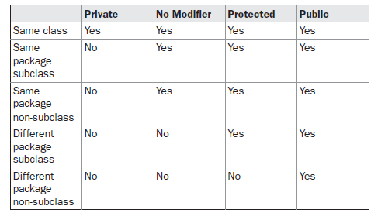
Access Protection(contd.)

Slide 14
Access Protection(contd.)
A non-nested class has only two possible access levels:
default
public.
When a class is declared as public, it is accessible by any other code.
public class A {////
}
If a class has default access, then it can only be accessed by other code within its same package.
class B
{ }
When a class is public, it must be the only public class declared in the file, and the file must have the same name as the public class.

Slide 15
Importing Packages
All of the standard classes are stored in some named package.
If we want to use classes in some other packages, they must be fully qualified with their package name or names,. It is difficult to type in the long dot-separated package path name for every class we want to use.
– TO SOLVE THIS PROBLEM, we can use
import
certain
statement. The import statement helps to bring
classes, or entire packages, into visibility.
To use a class or a package from the library, we need to use the
import keyword
import statements is written after the package statement(if exists) and before all class definitions.

Slide 16
Importing Packages(contd.)
General form of the import statement:
import pkg1[.pkg2].(classname|*);
– Here, pkg1 is the name of a top-level package, and pkg2 is the name of a subordinate package inside the package pkg1 separated by a dot
E.g.
import pack1;
// import the package pack1
import java.io.*; // import all the classes from the package java.io
import java.util.Date; //import the Date class from the package java.util

Slide 17
Importing Packages(contd.)
All of the standard Java classes included with Java are stored in a package called java
The basic language functions are stored in a package inside of the java package called java.lang
– it is implicitly imported by the compiler for all programs.

Slide 18
Importing Packages(contd.)
Using an import statement:
import java.util.*;
class MyDate extends Date {
//statements , methods,variables
}
Without the import statement looks like this: class MyDate extends java.util.Date
{
}

Slide 19
Without Using import statement- we have to use class from other package as packagename.classname (fully quantified)
//Program B.java package pack2; class B{
public static void main(String args[])
{
pack1.A obj = new pack1.A(); obj.msg(); System.out.println(“c="+obj.c);
//System.out.println("d="+obj.d);
// cannot access protected of
//different package i.e. pack1
//System.out.println("a="+obj.a);
/ /cannot access private of other class
}
//Program A.java package pack1; public class A
{
int a=100;
public int c=20;
protected int d=50;
public void msg()
{
System.out.println("Base class A Hello");
}
}
}
19

Slide 20
Using import package.* statement to import all classes in pack1 to program file in pack2
//Program A.java package pack1; public class A
{
int a=100;
public int c=20; protected int d=50; public void msg()
{
System.out.println("Base class A Hello");
}
}
//Program B.java package pack2; import pack1.*; class B{
public static void main(String args[])
{
A obj = new A(); obj.msg();
System.out.println(“c="+obj.c);
//System.out.println("d="+obj.d);
// cannot access protected of different package pack1
//System.out.println("a="+obj.a);/
/ /cannot access private of other class
}
}

Slide 21
Using import package.classname statement to import class A in pack1 to program file in pack2
//Program A.java package pack1; public class A
{
int a=100;
public int c=20; protected int d=50; public void msg()
{
System.out.println("Base class A Hello");
}
}
//Program B.java package pack2; import pack1. A; class B{
public static void main(String args[])
{
A obj = new A(); obj.msg();
System.out.println(“c="+obj.c);
//System.out.println("d="+obj.d);
// cannot access protected of different package pack1
//System.out.println("a="+obj.a);/
/ /cannot access private of other class
}
}

Slide 22
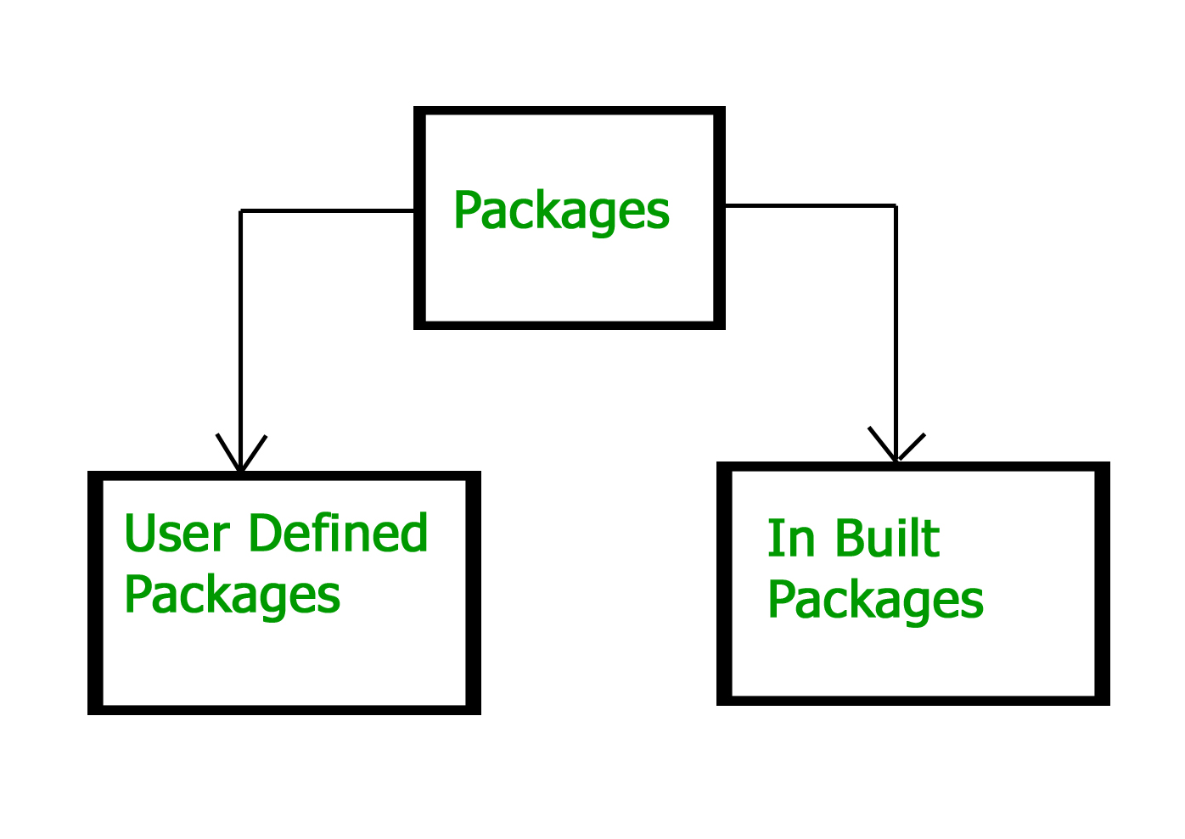

Slide 23
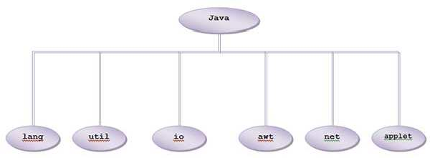
Built-in Packages

Slide 24
Java Foundation Packages
Java provides a large number of classes grouped into different packages based on their functionality.
The six foundation Java packages are:
java.lang
Contains classes for primitive types, strings, math functions, threads, and exception
java.util
Contains classes such as vectors, hash tables, date etc.
java.io
Stream classes for I/O
java.awt
Classes for implementing GUI – windows, buttons, menus etc.
java.net
Classes for networking
java.applet
Classes for creating and implementing applets

Slide 25
Steps and examples for creating and using
packages

Slide 26
Create a folder pack1 inside D drive
Create a file A.java package pack1; public class A
{
public static void main(String args[] )
{
System.out.println("Hello");
}
public void show()
{System.out.println(“show in A");
}
}
26

Slide 27
Method 1
Take path before pack1 folder it s D drive.
Compile using
D:\>javac pack1/A.java
To run
in command prompt here
D:\>java pack1/A
Or
D:\>java pack1.A
27

Slide 28
Method 2
Set classpath in command prompt to path to folder before the package pack1
C:\Users\USER>set CLASSPATH=;D:\
To compile
C:\Users\USER>javac -cp . D:\pack1\A.java
To run
C:\Users\USER>java pack1.A Hello

Slide 29
Method 3:
Using –classpath option
Compile using
C:\Users\USER>javac D:\pack1\A.java
Or
C:\Users\USER>javac -classpath . D:\pack1\A.java
Run using
C:\Users\USER>java -classpath D:\ pack1.A

Slide 30
E.g using import statement
Create a folder pack2 inside D drive
Create a file B.java in it package pack2;
import pack1.*; class B{
public static void main(String args[])
{
A obj = new A(); obj.show();
System.out.println(“main in class B");
D:\>javac pack1\A.java
D:\>javac pack2\B.java
D:\>java pack2.B show in A
main in class B
}
}
Prepared by Renetha J.
30

Slide 31
Reference
Herbert Schildt, Java: The Complete Reference, 8/e, Tata McGraw Hill, 2011.
31

